Slide 1

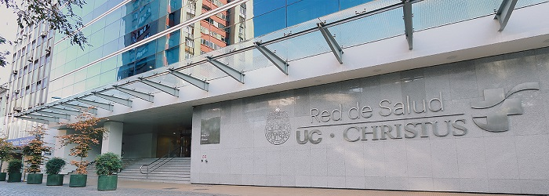
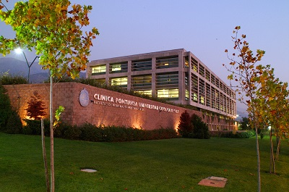
Intraocular cytology
Dr. Pablo Zoroquiain PhD
Ocular pathologist and cytopathologist
Associate Professor,
Pontificia Universidad Católica de Chile.

Slide 2
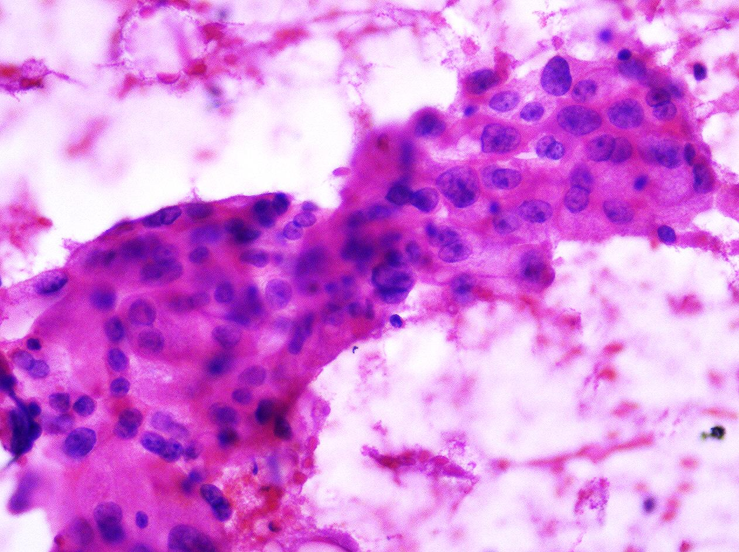
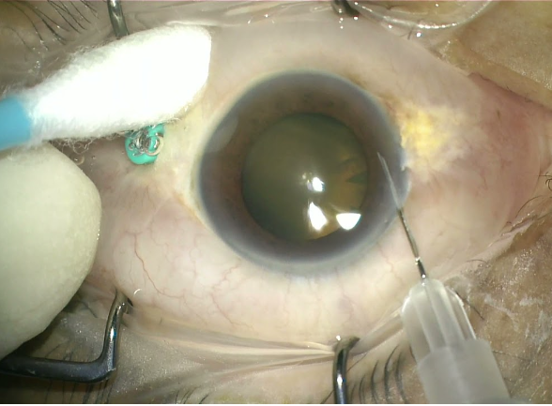
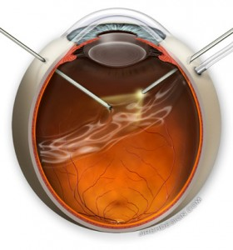
Intraocular sampling

Slide 3
2 more common scenario
Masquerade síndrome (vitreous sampling)
  Inflamatory infectious conditions
  Lymphoma
  Other entities
Intraocular tumor
  Direct sampling
  Aqueous tap

Slide 4
Masquerade syndrome
Necrotizing retinitis
  CMV
  HSV
  Toxoplasma
  Endophtalmitis
Lymphoma
  DLBCL CNS type (PIOL)
Others: Uveitis, amiloidosis

Slide 5
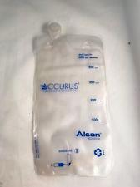
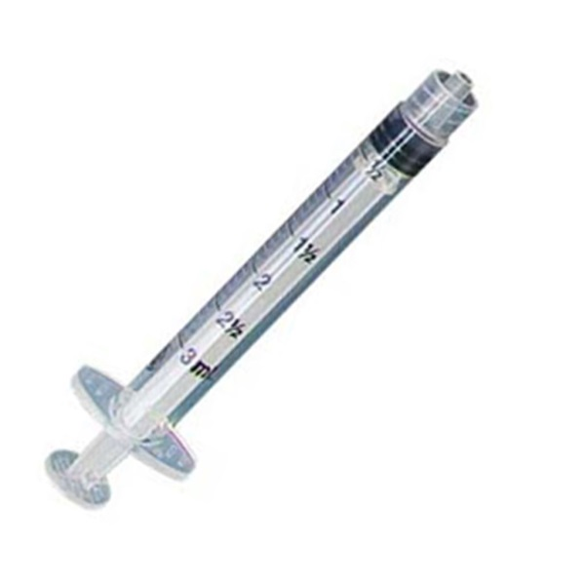
Masquerade syndrome
3 samples
  Undiluted vitreous
  Diluted vitreous
  Cassette

Slide 6
Processing
Create a direct smear with 2 drops (undiluted)
  Stain with PAP ultra fast to diferentiate:
    Inflamatory cells
    Large atypical cells
    Other material

Slide 7
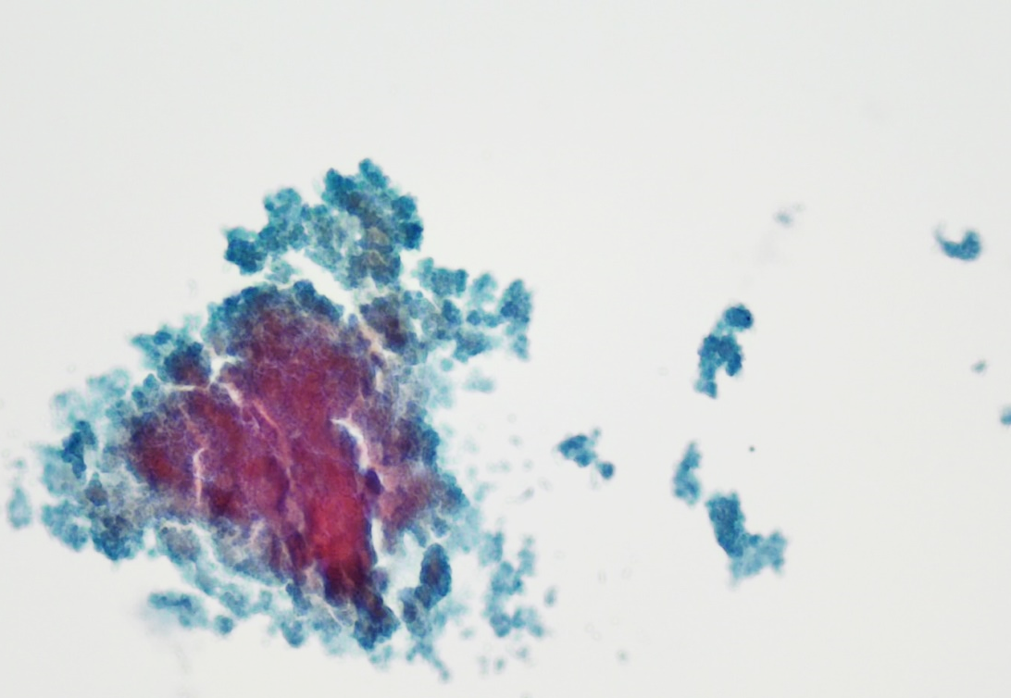
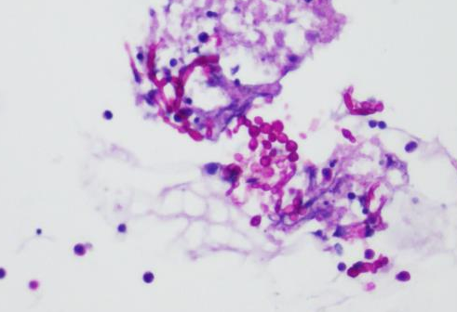
Triage with inflammation
Neutrofils and necrotic debri
  PCR and cultures with the diluted and undiluted sample
  Cytospins from the cassette
Chronic endophthalmitis due to candida after cataract surgery.

Slide 8
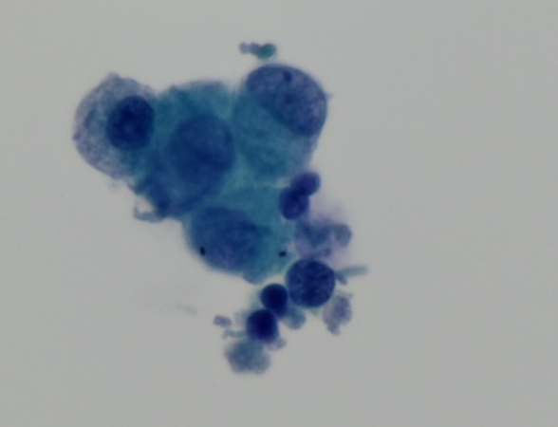
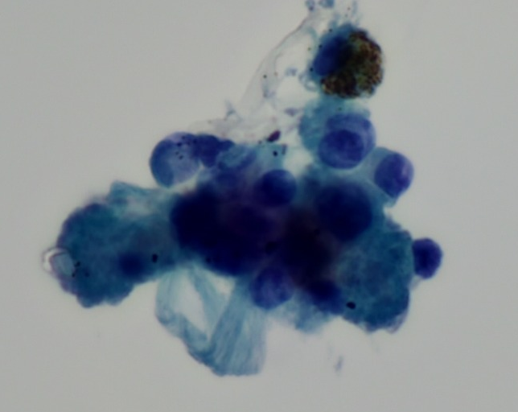
Triage with inflammation
Histiocytes
  PCR and cultures with the diluted and undiluted sample
  Cytospin of cytocentrifugate of cassette
Sarcoidosis. (QT negative and Ct-scan consistant.)

Slide 9
Processing
Create a direct smear with 2 drops (undiluted)
  Stain with PAP ultra fast to diferentiate:
    Inflamatory cells
    Large atypical cells
    Other material

Slide 10
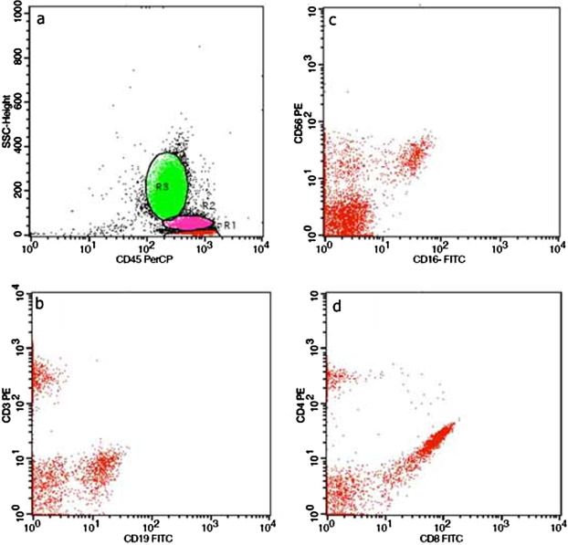
Triage with discohesive malignant cells
Flow cytometry (undiluted)
ICC (diluted vitreous/cassette)
    CD3/CD20.
    panCK.
    HMB-45/PAX8.

Slide 11
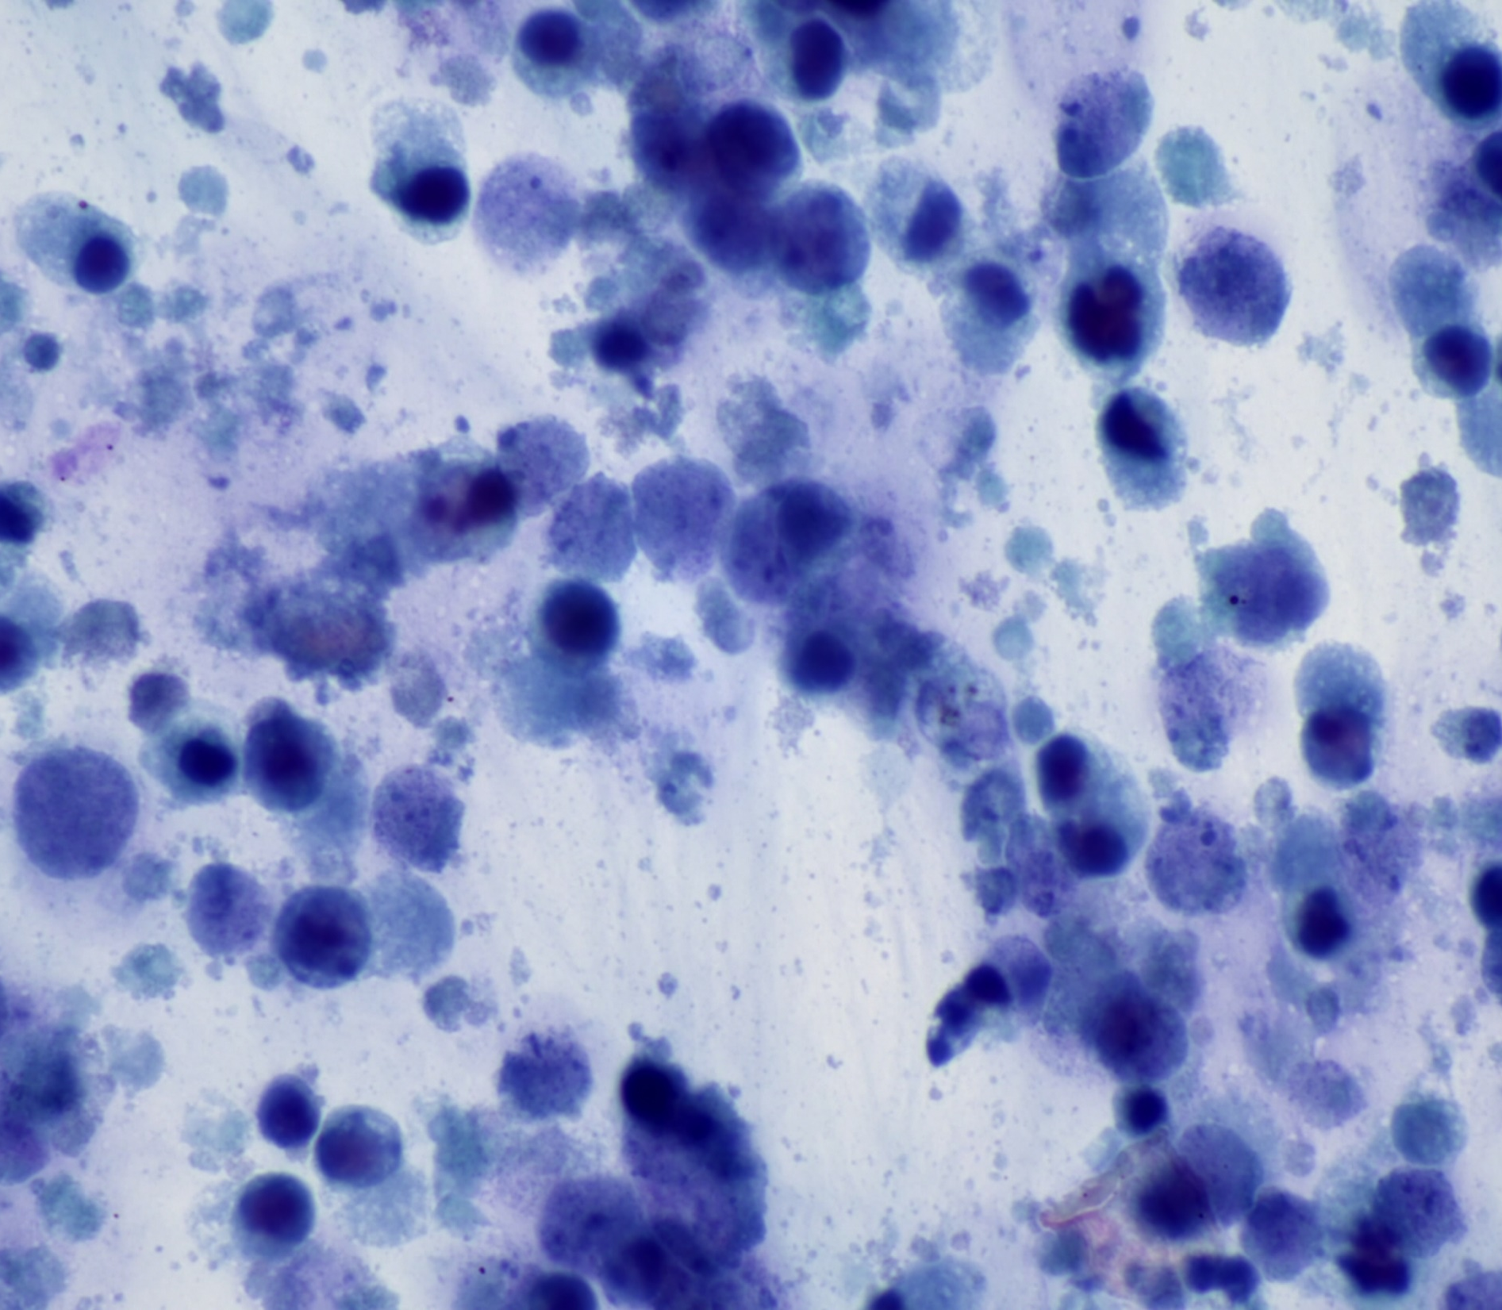
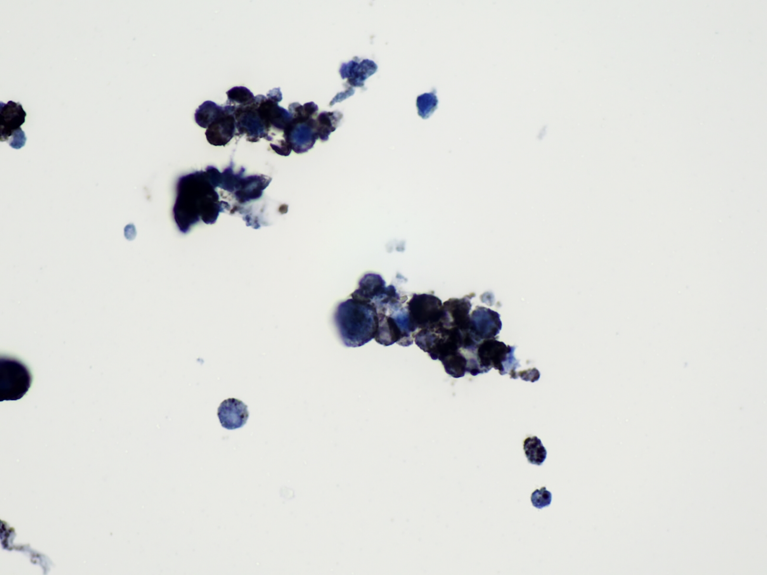
Vitrectomia
CD20

Slide 12

Ancilliary techniques

Slide 13
ICC versus FC
Immunocytochemistry
Flow cytometry
Large amount of cells
  One Ab per slide.
Morphology
  Posible: Can detect other non-lymphoid malignancyies
Handling
  Refrigerated in fresh or fixed with 70% alcohol.
Low amount of cells
  Multiple Ab simultaneously
Morphology
  Not posible: Can result in false negatives (carcinoma , HL and other low-grade lymphomas)
Handling
  Refrigerated and using culture media.

Slide 14
PCR
IGH gene clone rearrangement and BCL-2 t(14,18) rearrangement
  Multiplex technique.
  Good overall specificity ( 1/86 uveitis positive)
  Variable sensitivity
    Amount of cells
    Technique single/multiplexes/nested
Lobo, A et al. Protocol for the use of polymerase chain reaction in the detection of intraocular large B-cell lymphoma in ocular samples. J Mol Diagn. 2007.
Wang, Y et al. Molecular biomarkers for the diagnosis of primary vitreoretinal lymphoma. Int J Mol Sci. 2011

Slide 15
Biochemical analysis (ELISA)
IL-10 is a growth and differentiation factor of B lymphocytes
IL-6 and IL-12 elevated in inflammatory processes
A ratio IL-10:IL-6 >1 showed a 74-89% sensitivity and 75-93% specificity for lymphoma diagnosis.
Buggage, R.R et al. Using interleukin 10 to interleukin 6 ratio to distinguish primary intraocular lymphoma and uveitis. Invest Ophthalmol Vis Sci. 1999
Cassoux, N et al. IL-10 measurement in aqueous humor for screening patients with suspicion of primary intraocular lymphoma. Invest Ophthalmol Vis Sci. 2007

Slide 16
Processing
Create a direct smear with 2 drops (undiluted)
  Stain with PAP ultra fast to diferentiate:
    Inflamatory cells
    Large atypical cells
    Other material

Slide 17
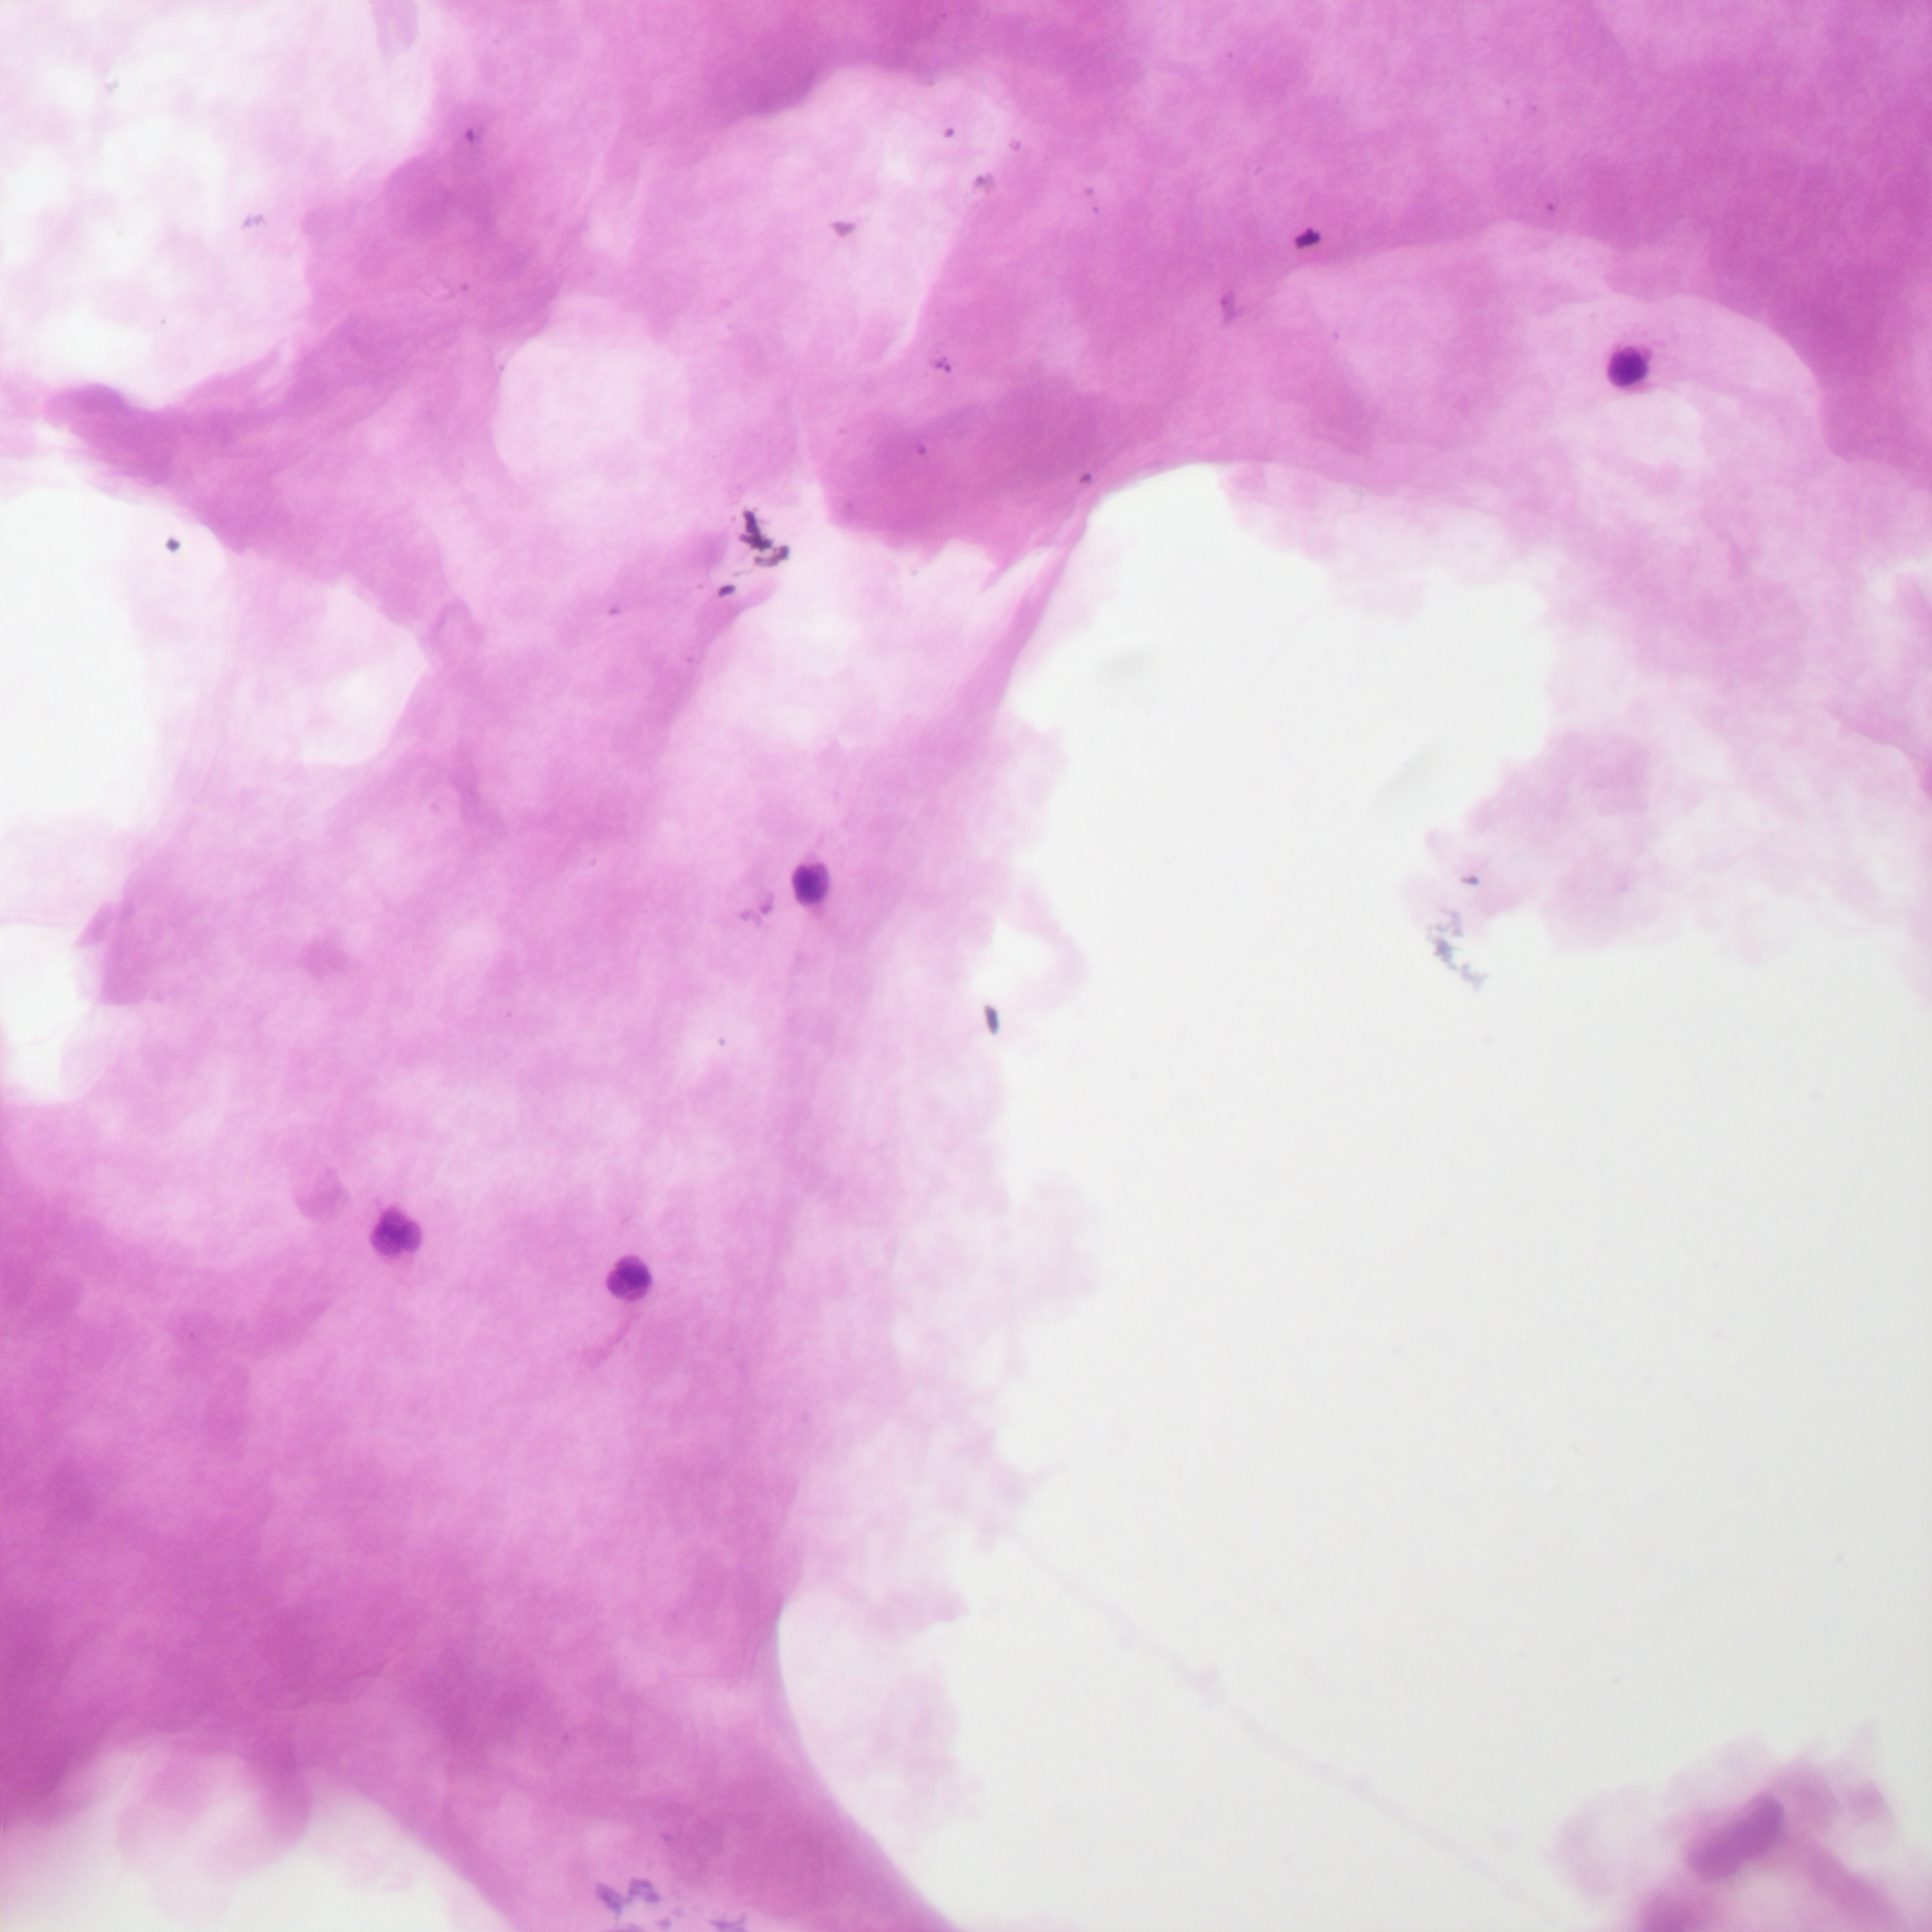
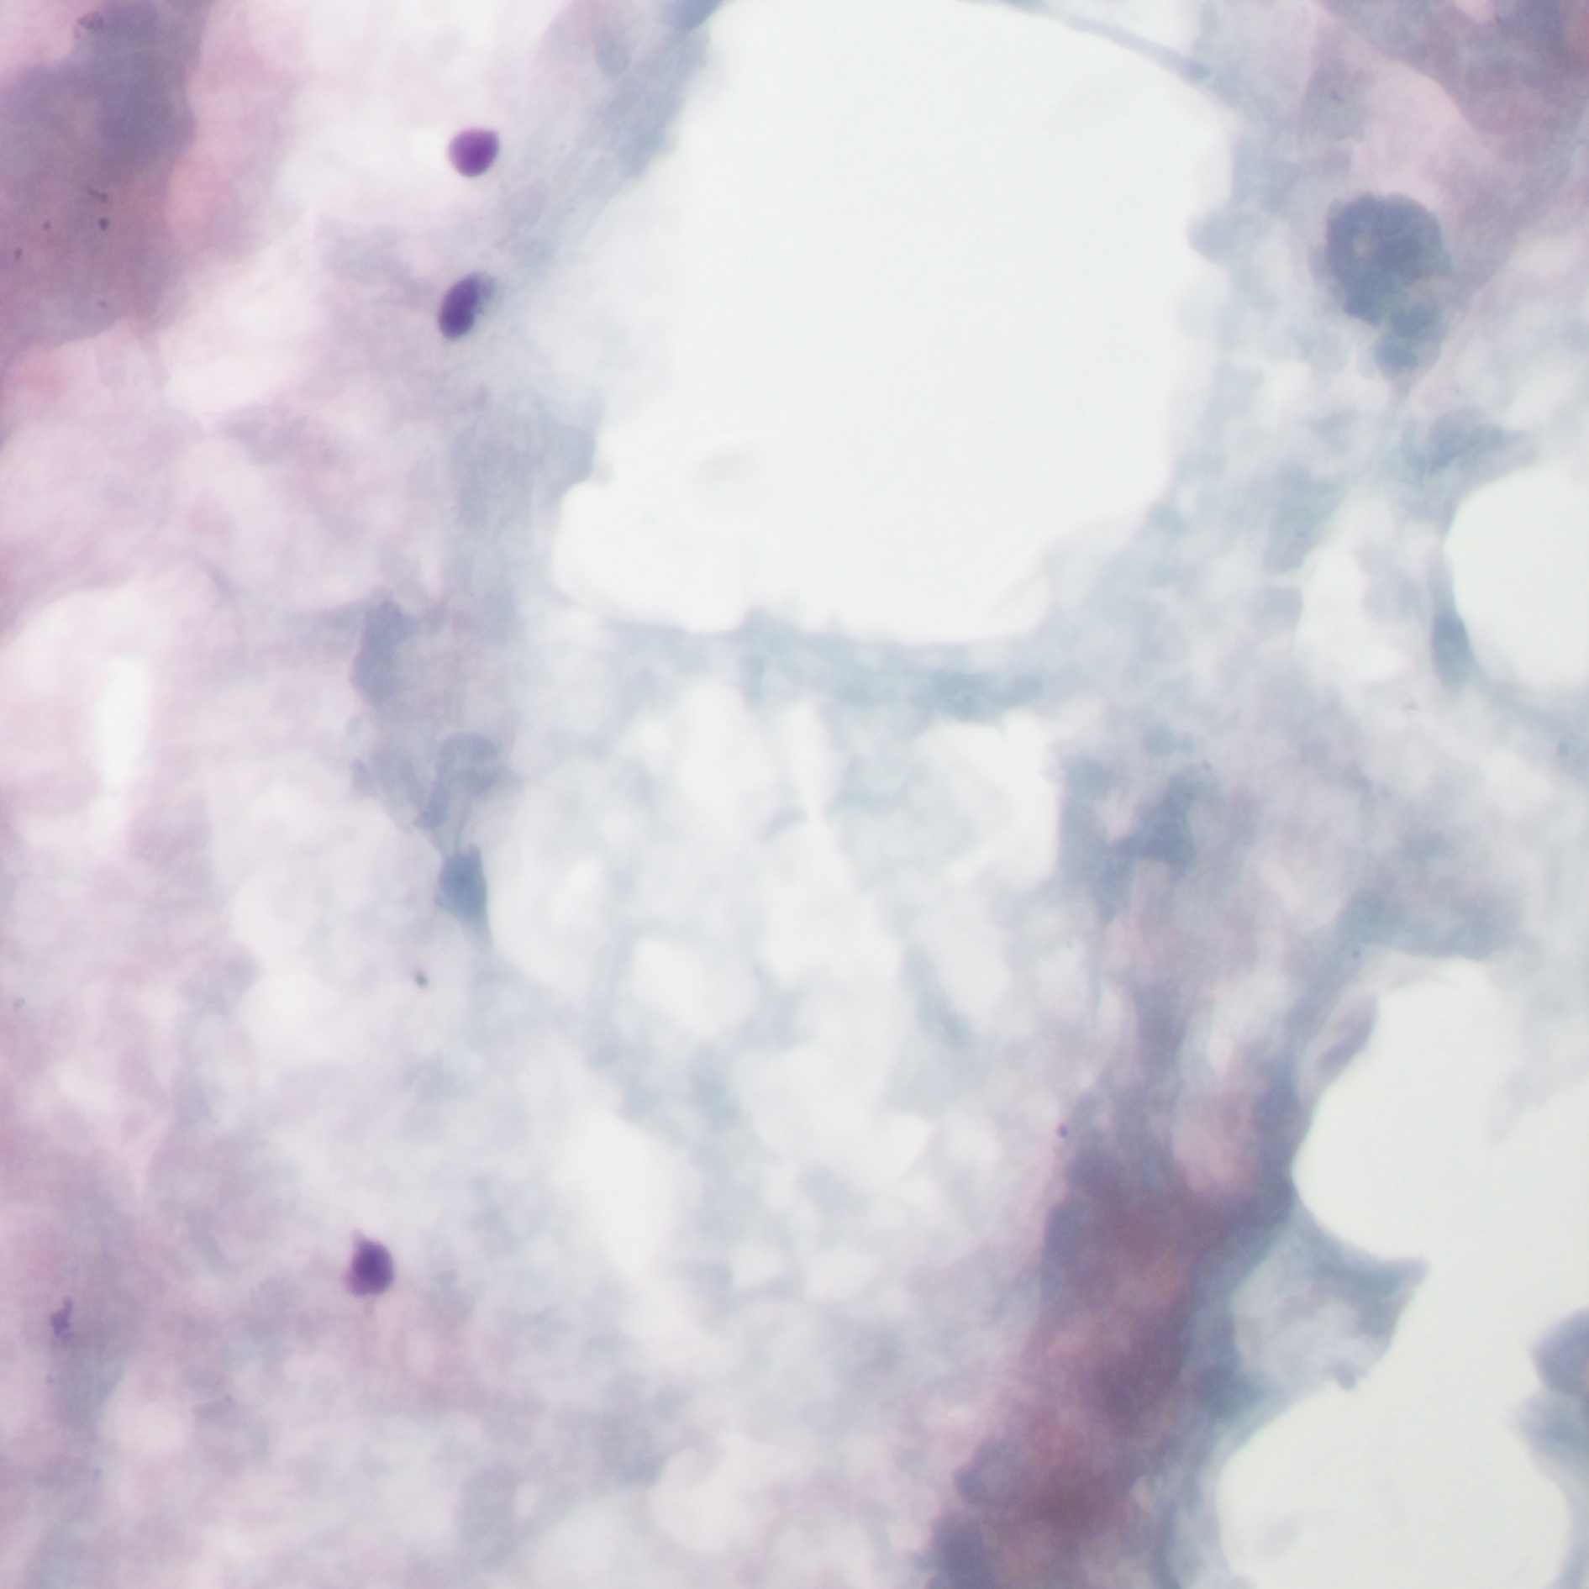

Slide 18
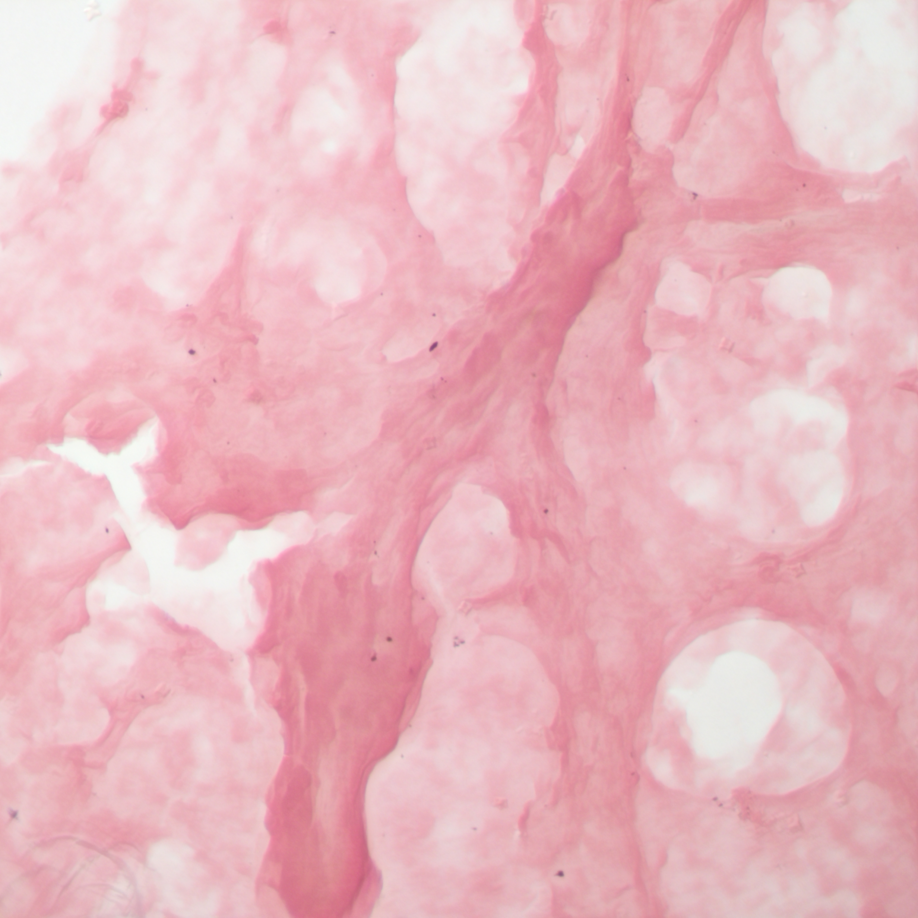
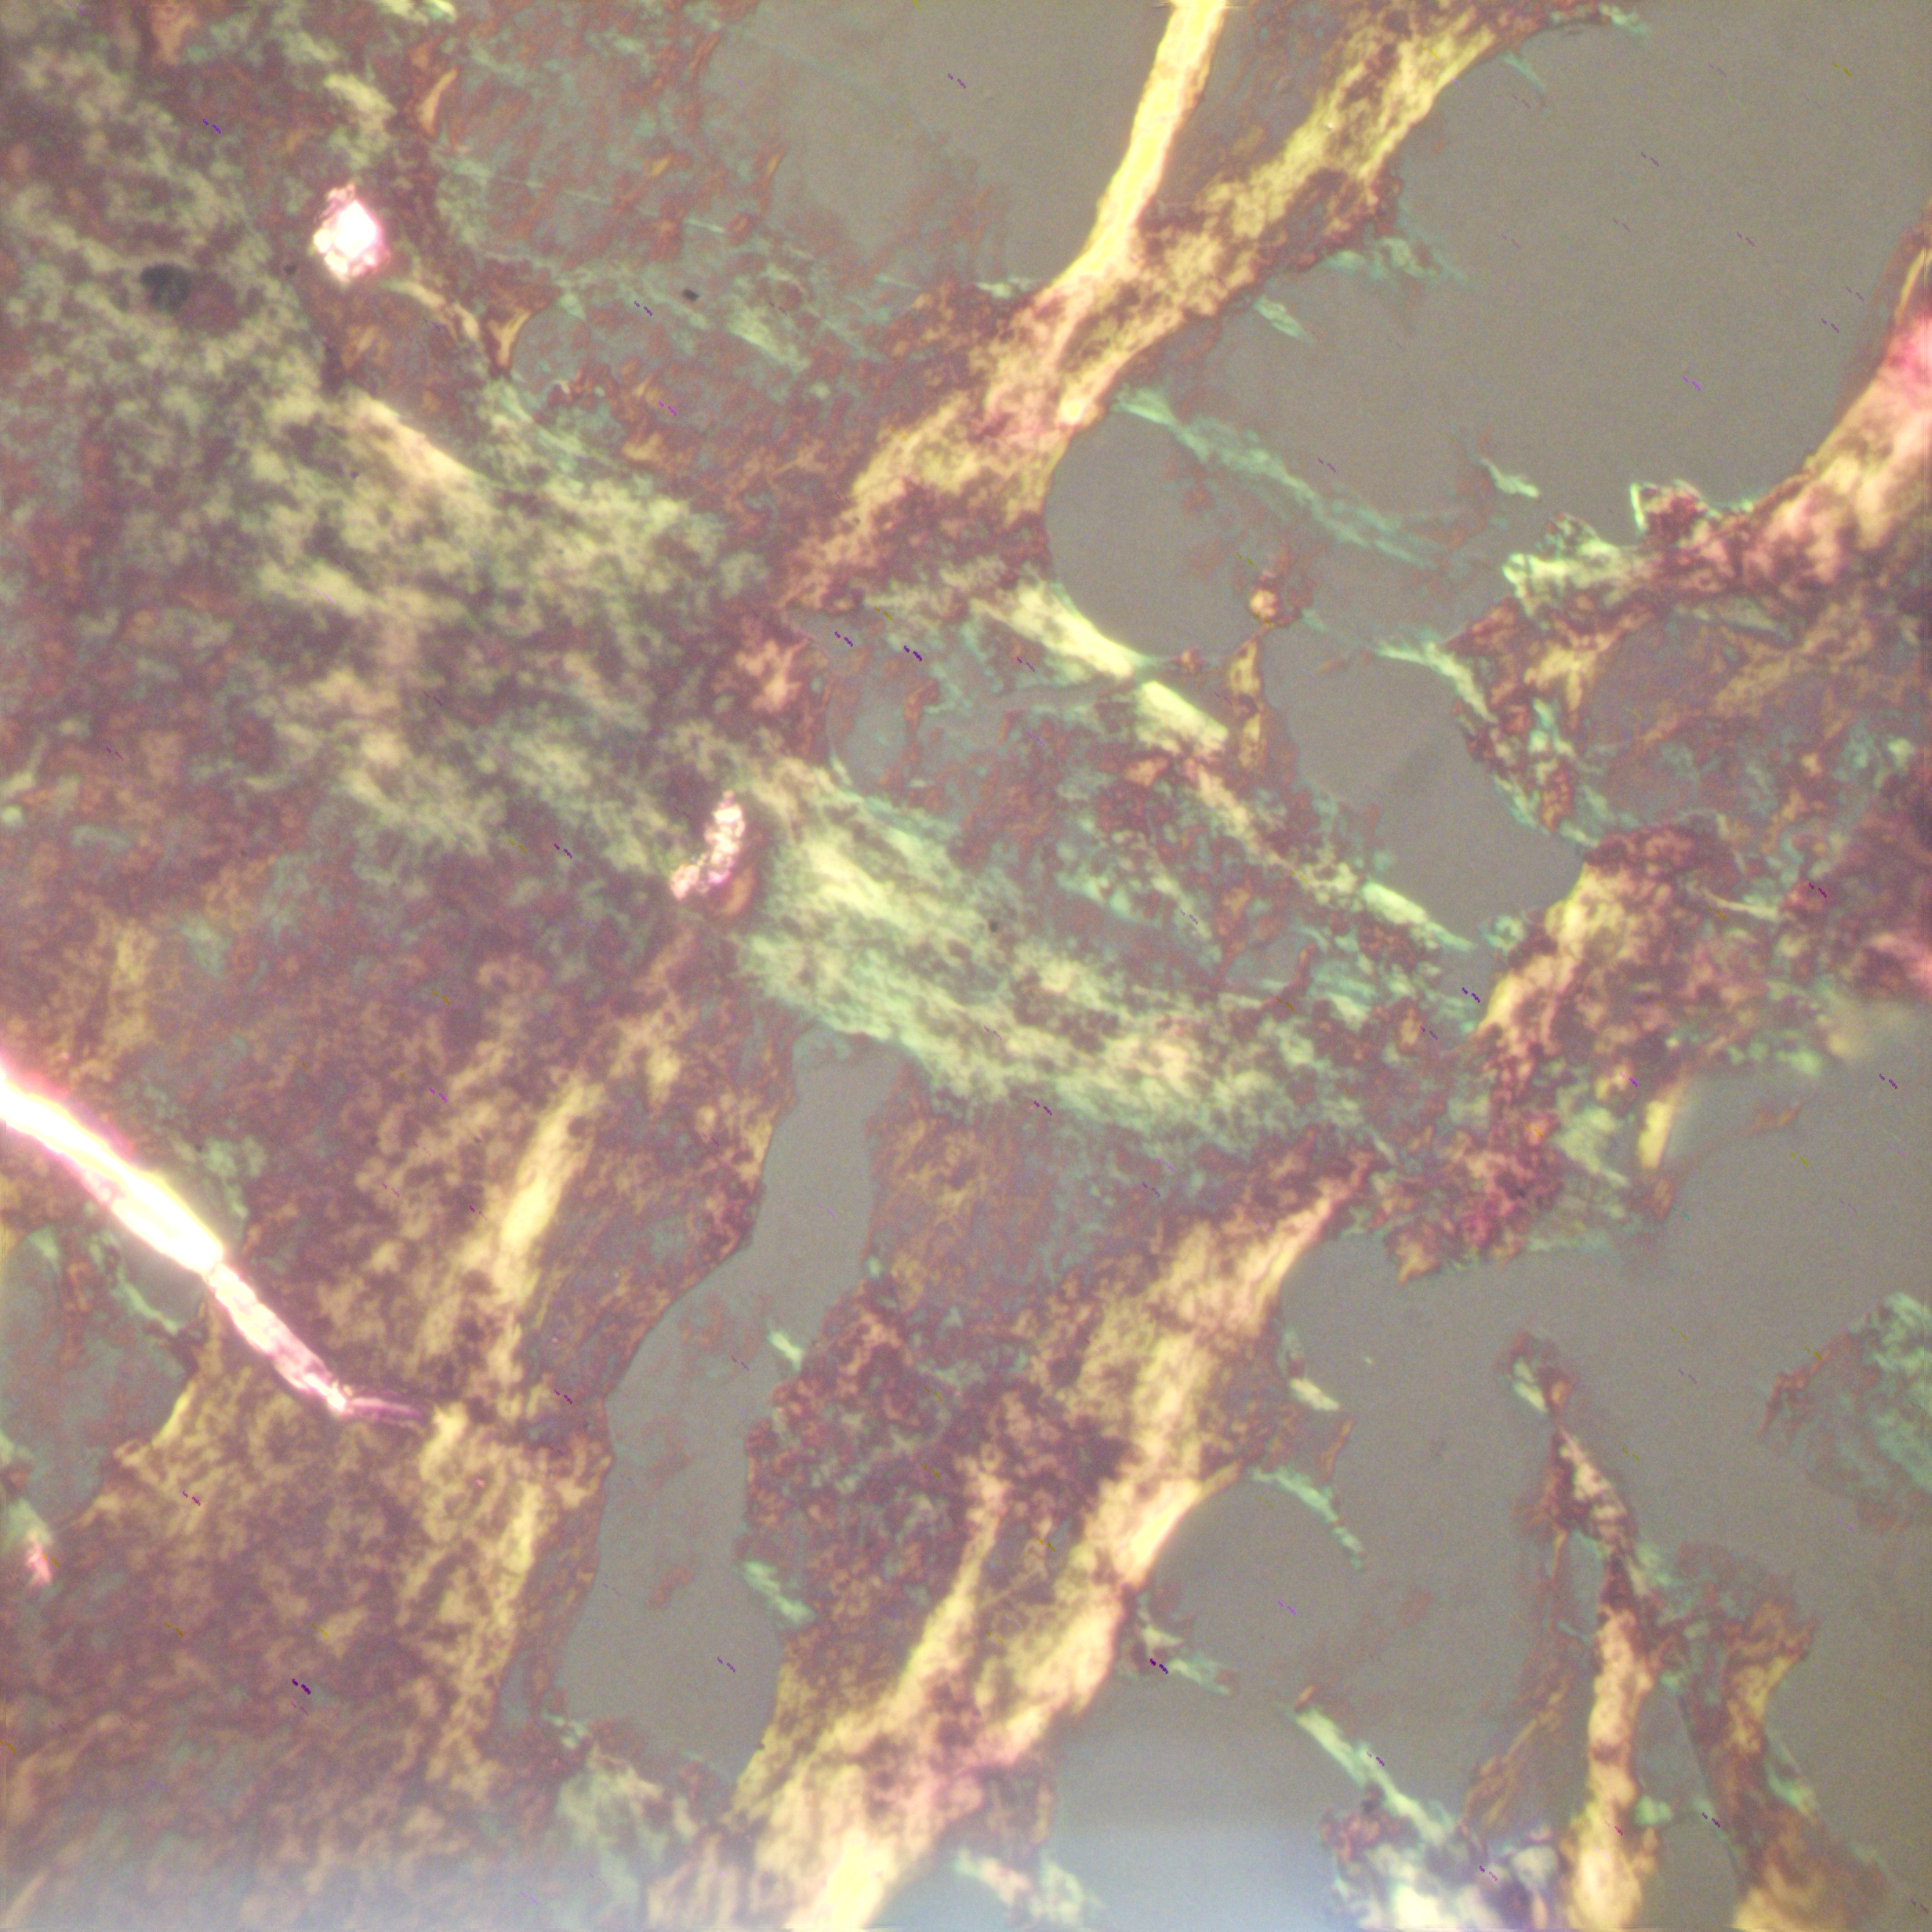
Congo Red

Slide 19
Diagnosis
Vitreal amiloidosis

Slide 20
2 more common scenario
Masquerade síndrome
  Inflamatory infectious conditions
  Lymphoma
  Other entities
Intraocular tumor
  Direct sampling
  Aqueous tap

Slide 21
CASE 1
55-year-old.
Ciliary body mass, pigmented.
US: low internal reflectivity.
  Melanocytoma vs Uveal Melanoma

Slide 22
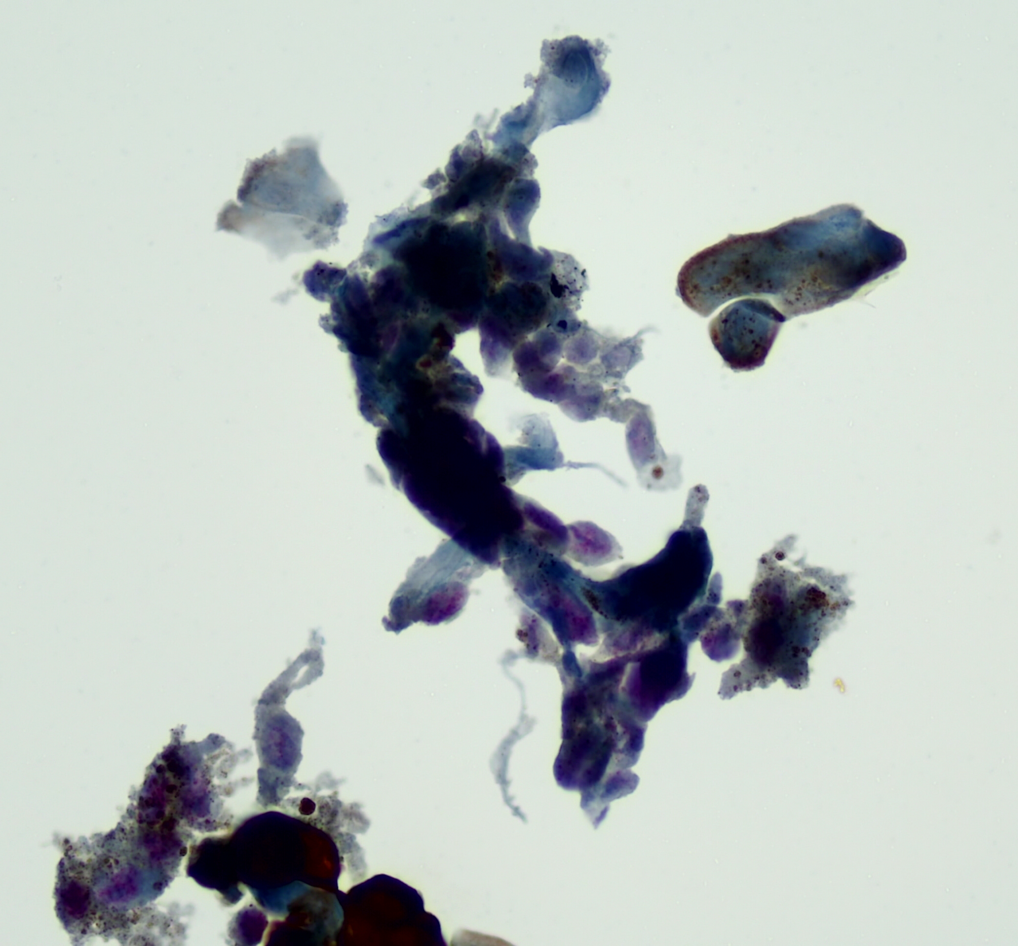
SOX10 + uveal melanoma cells

Slide 23
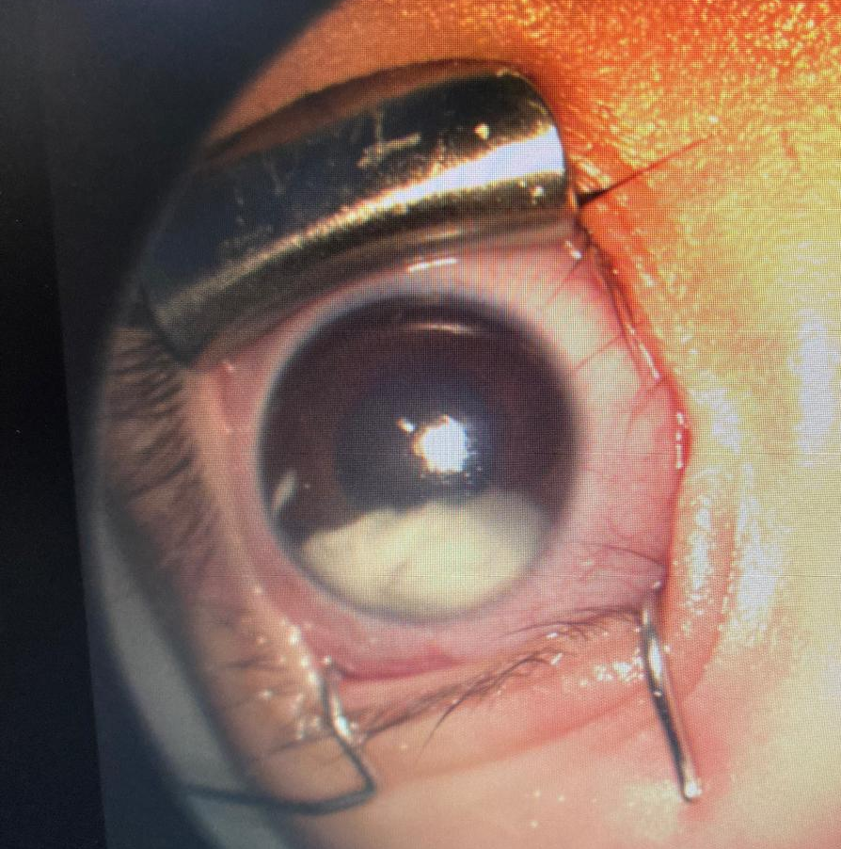
CASE 2
5-year-old male.
Hypopion
No other medical history

Slide 24
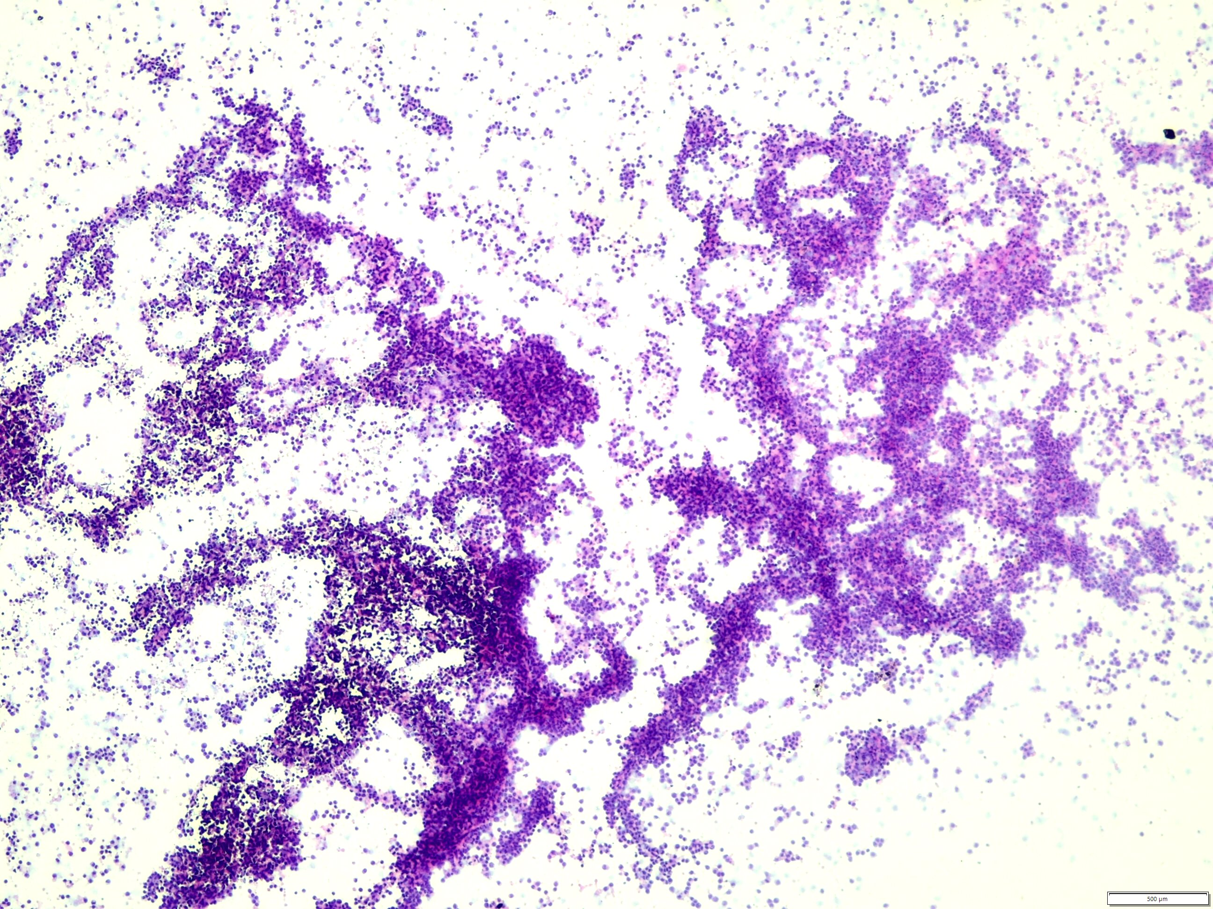

Slide 25
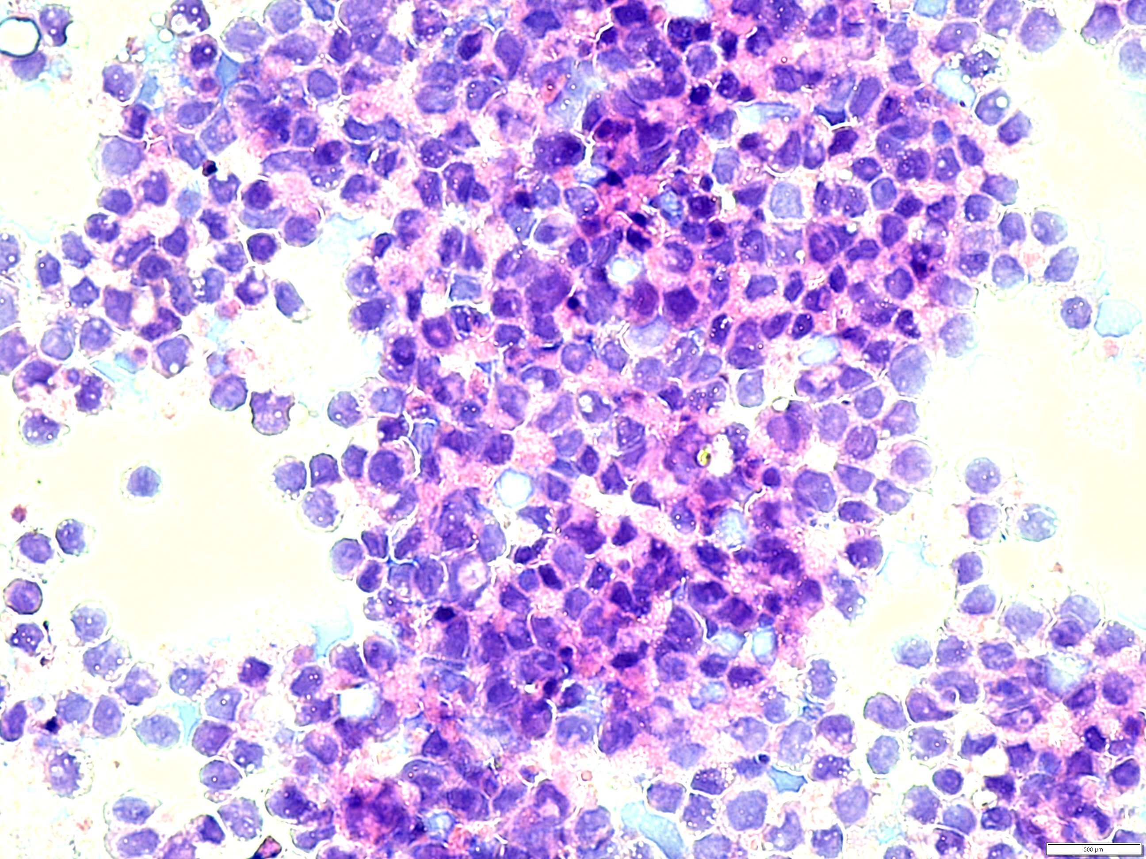

Slide 26
Skin lesions
Biopsied and sent for Flow cytometry
  Monocytic leukemia.

Slide 27
CASE 3
5 months-old female
Whitish lesion in inferomedial cuadrant.
Cloudy vitreous, with seeding?
US: high internal reflectivity.
Vitreous tap.

Slide 28
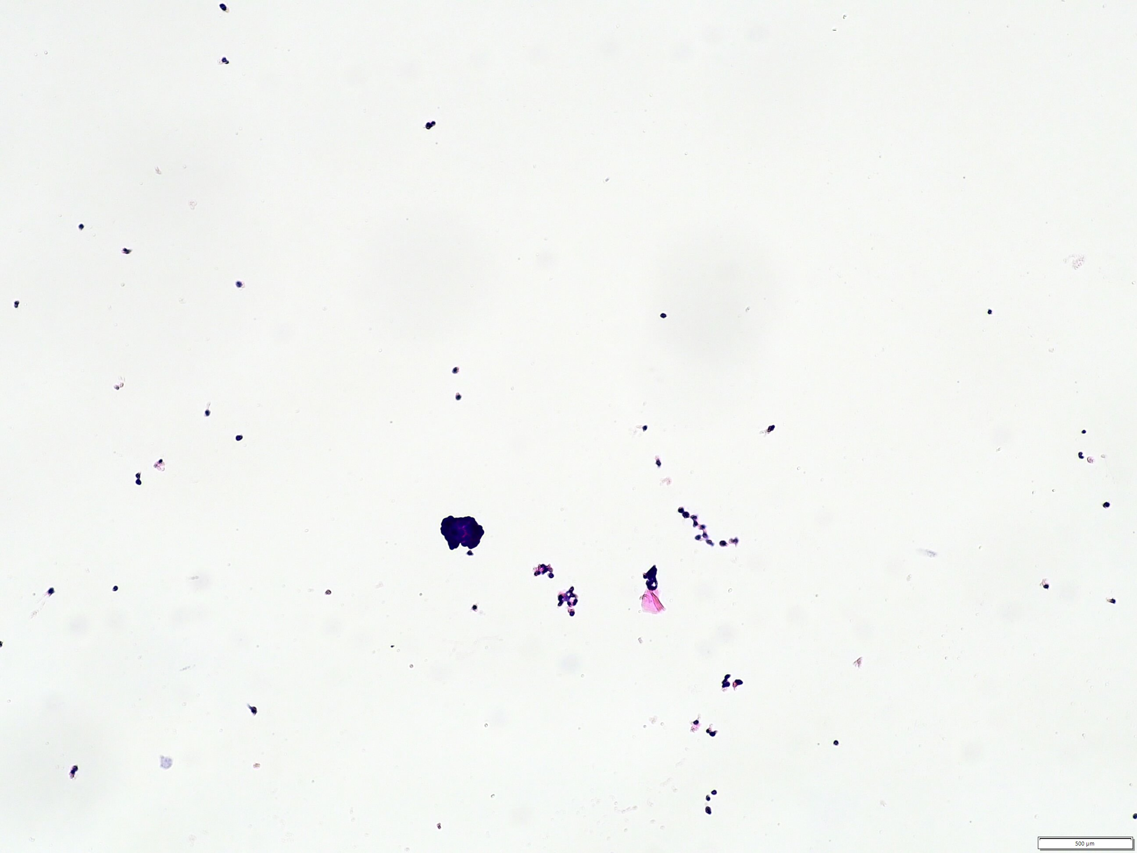
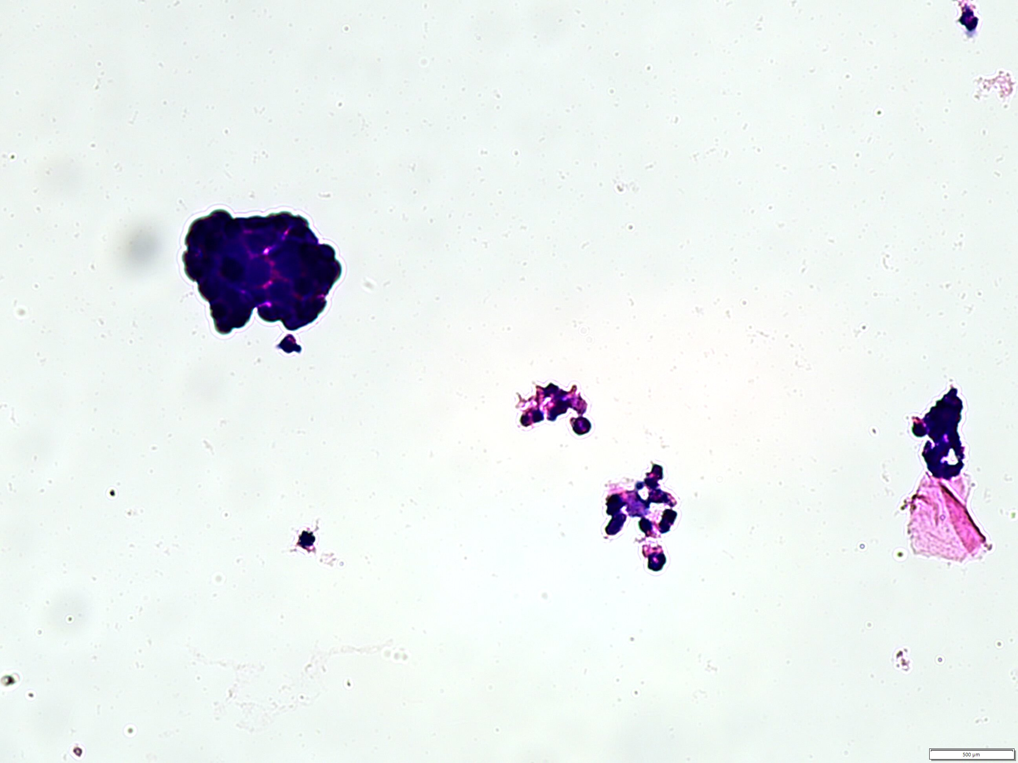

Slide 29
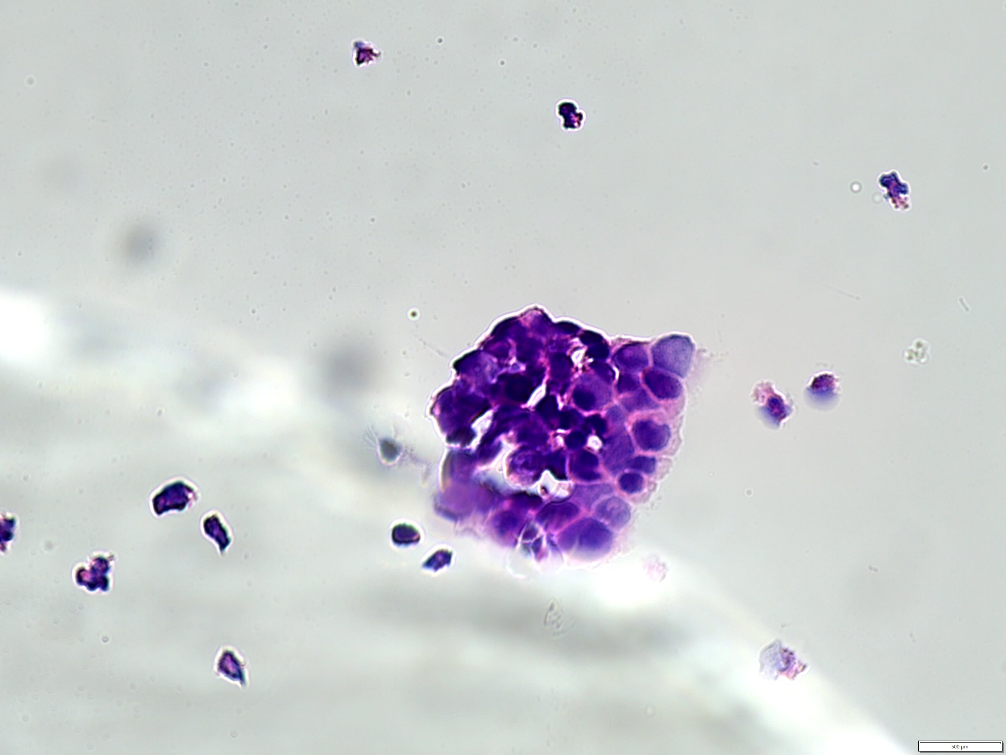
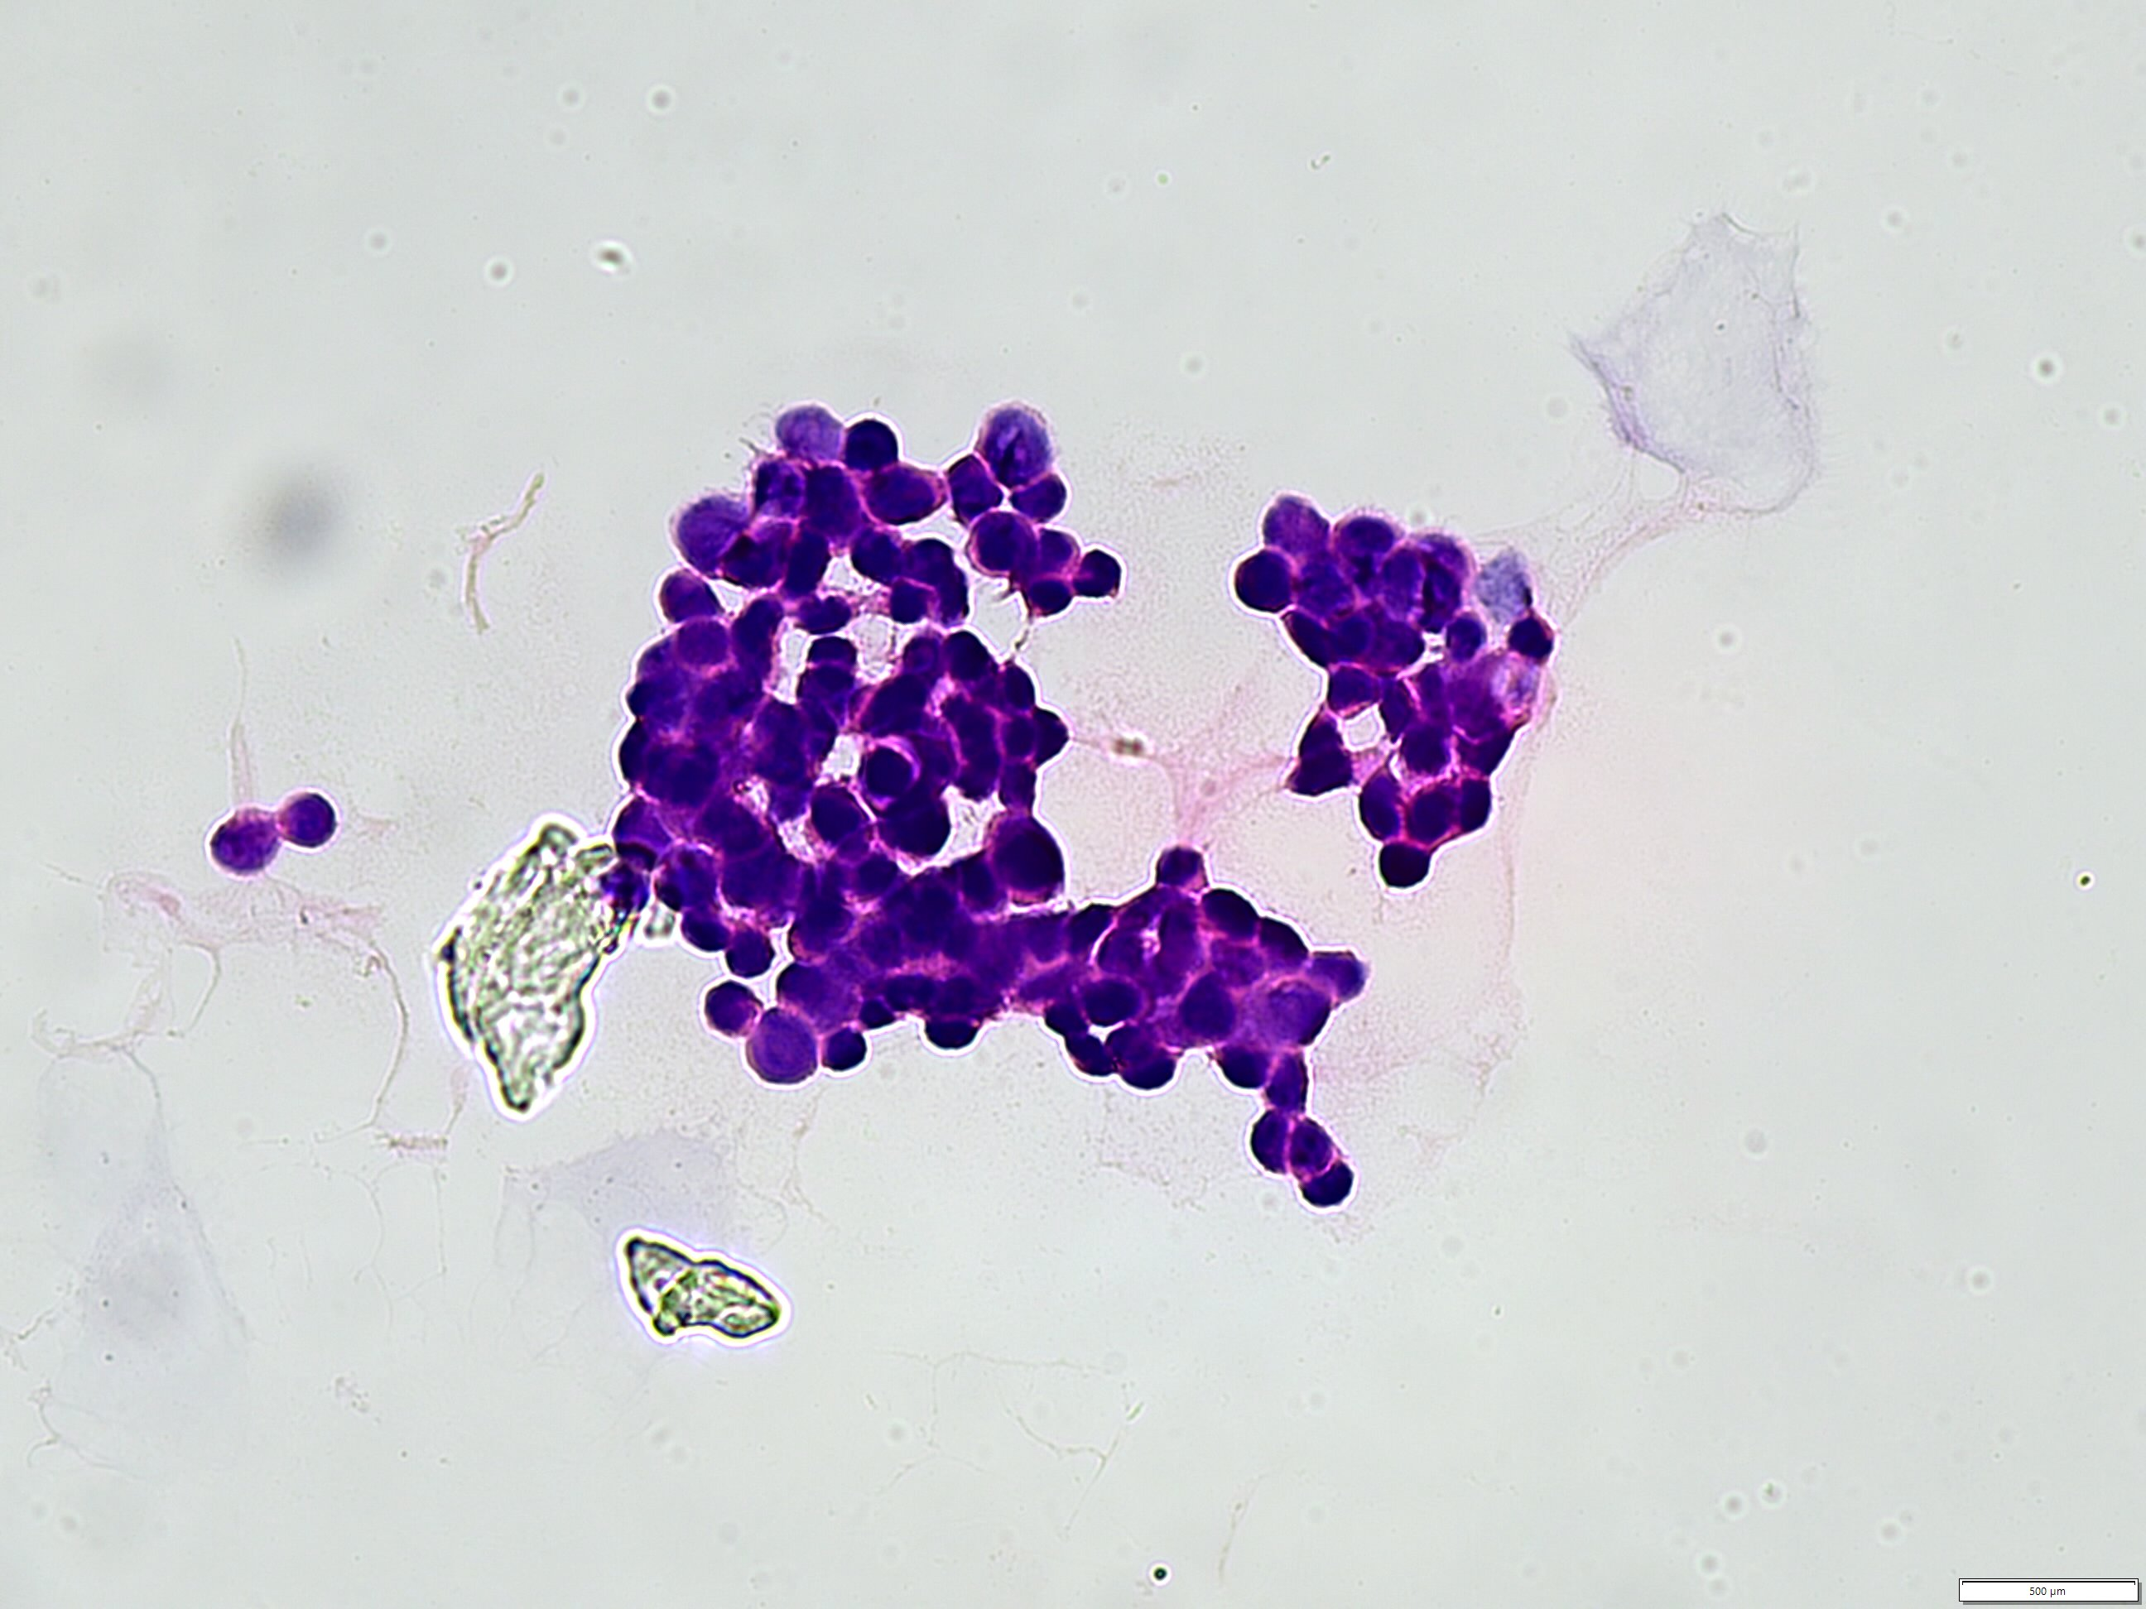

Slide 30
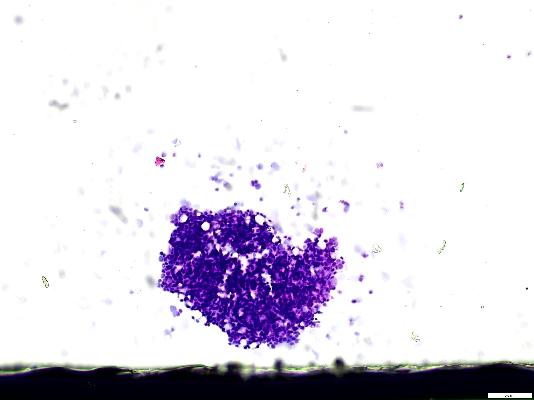
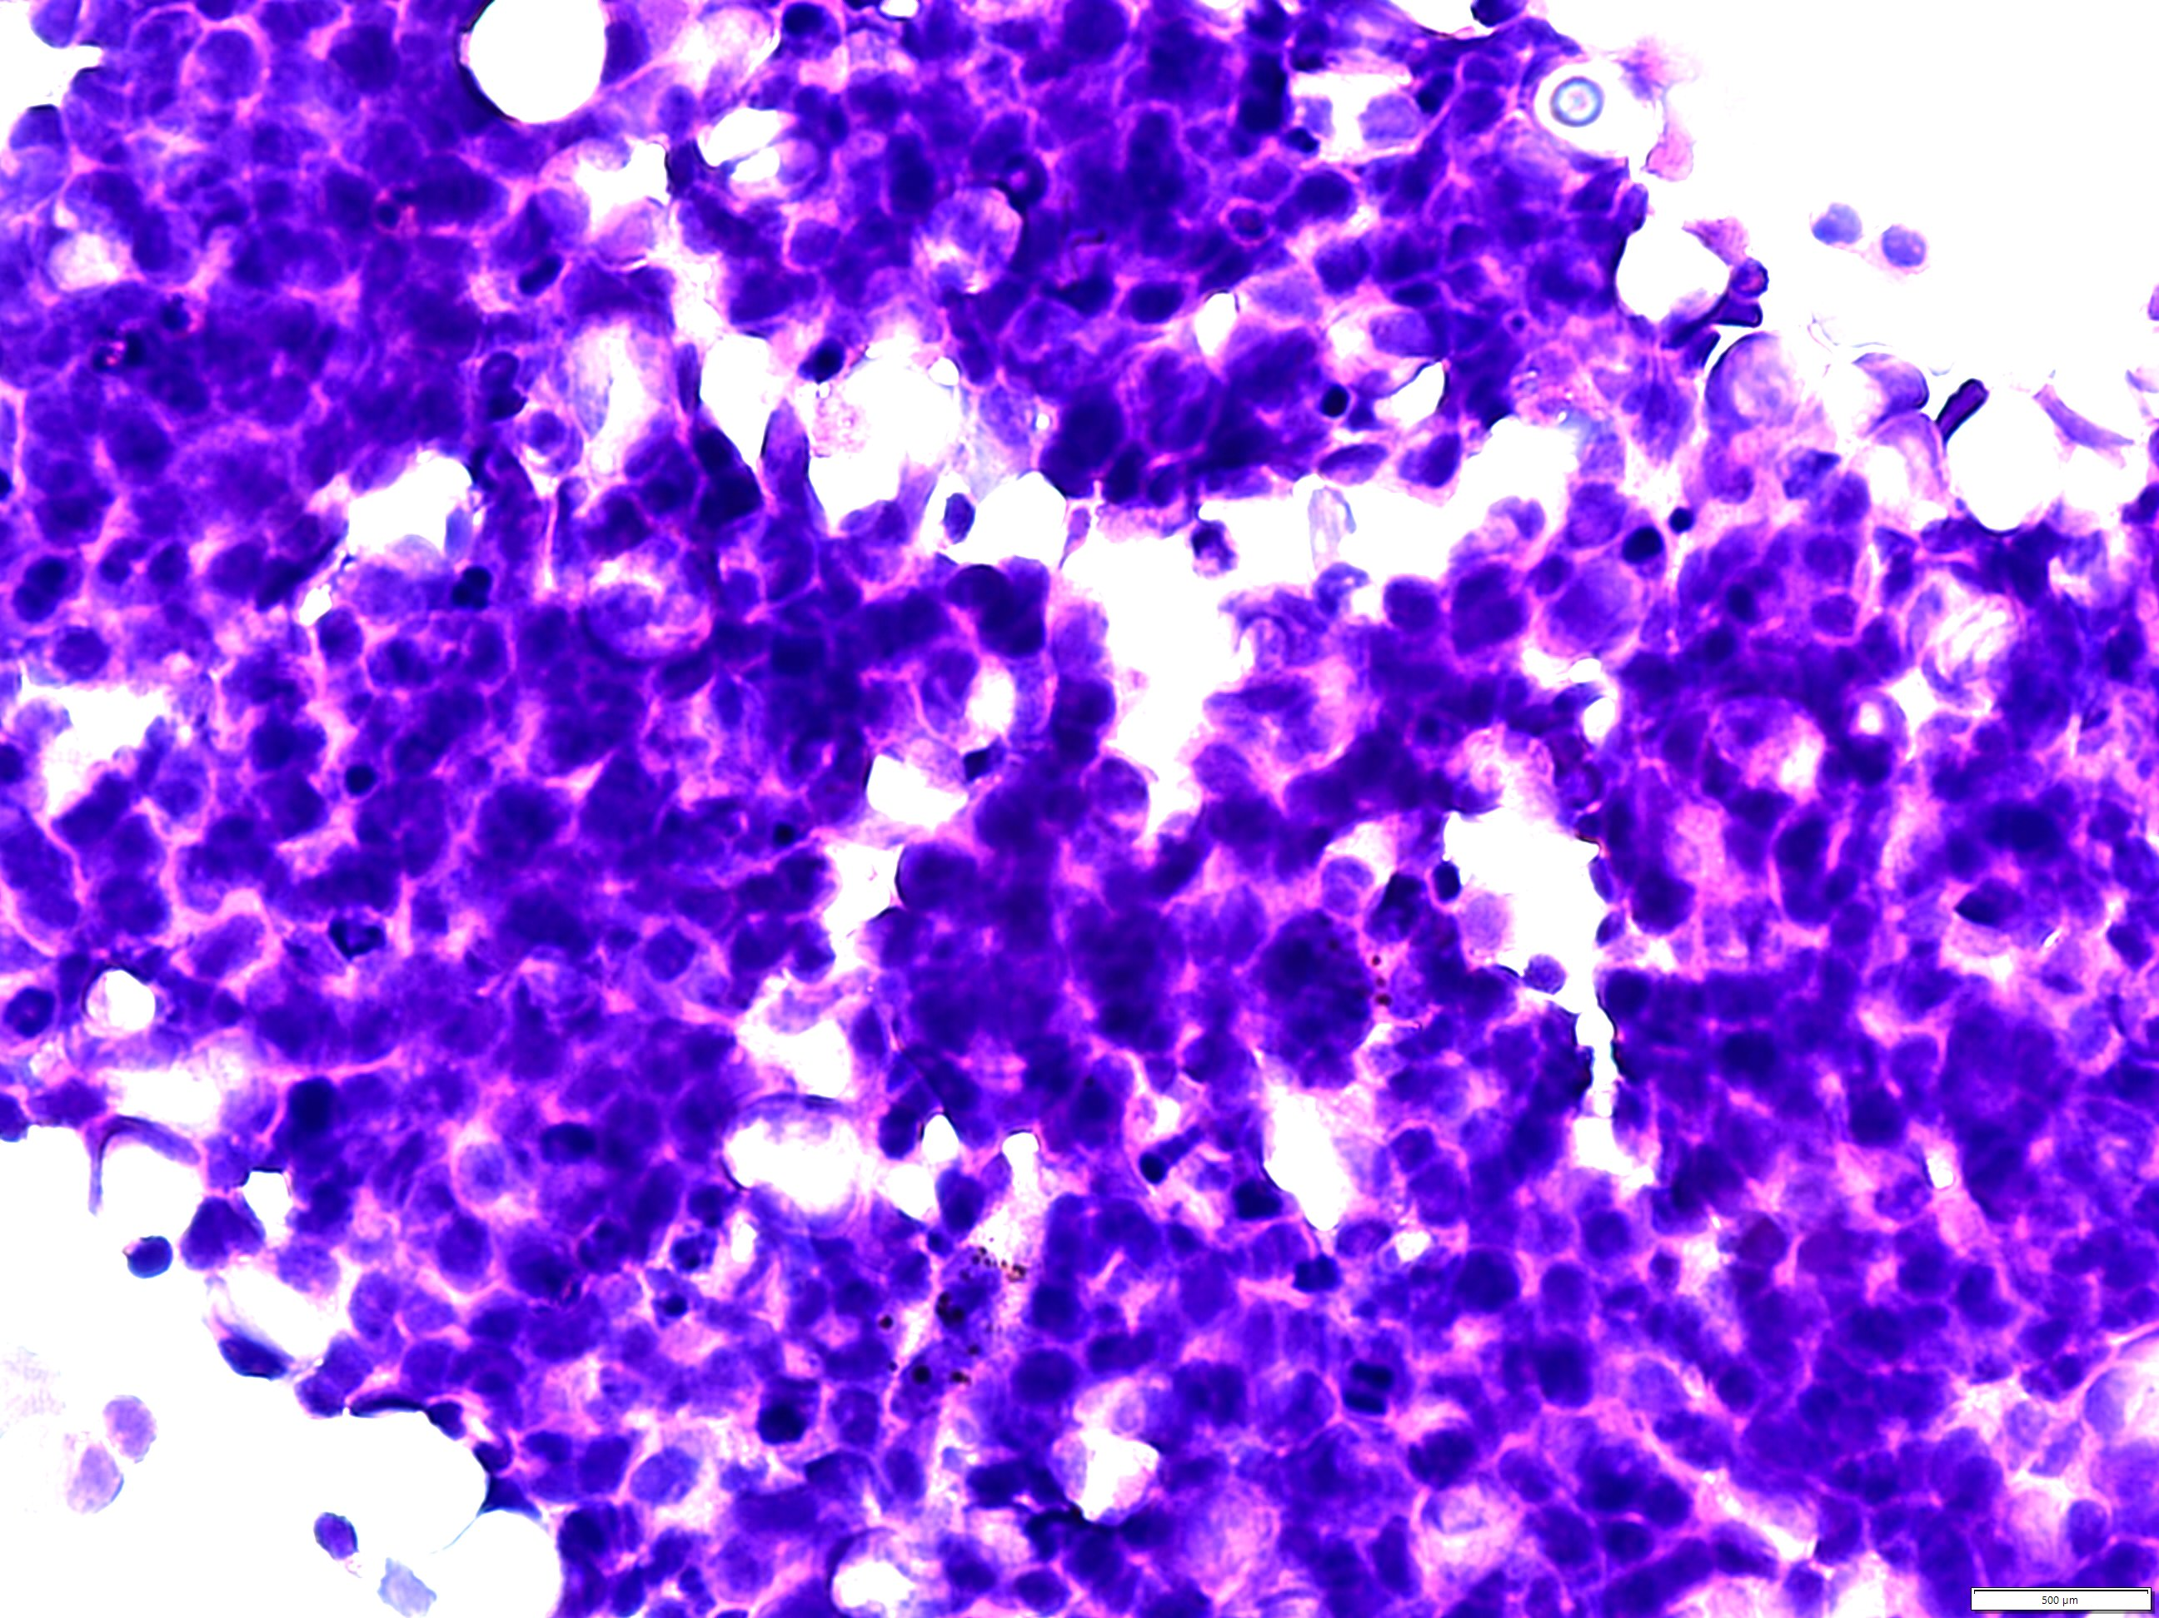

Slide 31
Diagnosis
Retinoblastoma

Slide 32
Taking home messages
Masquerade syndrome is a common clinical scenario.
Differential diagnosis is broad.
Sample is limited:
  Triage using undiluted vitreous helps to prioritize studies.
  Multidiciplinary collaboration is needed.

Slide 33
Obrigado!
Zoroquiain@gmail.com

